Slide 1


Analytics Hackathon 2023

Slide 2


Strategies
Understanding the given Problem Statement.
Researching on the factors that can affect the unemployment rate for each of the G7 countries over the years.
Gathering necessary and relevant historical data on the factors as much as possible at monthly level from reliable sources.
Applying a suitable forecasting technique, a statistical model which would be apt to predict the unemployment rates of the future months.

Slide 3
External factors considered
Working-age population, Labour force, Unemployment level of males, females & overall, Part-time & full-time employment numbers
Consumer Price Index (CPI)/ Producer Price Index (PPI)/ Gross Domestic Product (GDP)/ Monthly Inflation rates of any of these factors etc.
Average working hours, Wages of labourers, Total new job vacancies, Monthly labour costs, energy costs, other derived variables etc.
Employment rates, Inactivity rates/Labour Force Participation rates
Population figures
Rates & Proportions
Economic factors
Other factors

Slide 4

Data Sources
Unemployment - Unemployment rate - OECD Data
https://www.e-stat.go.jp/en/stat-search/files?stat_infid=000040046676
https://fred.stlouisfed.org/tags/series?t=france%3Bunemployment
www.ons.gov.uk
www.istat.it
www.statista.com

Slide 5
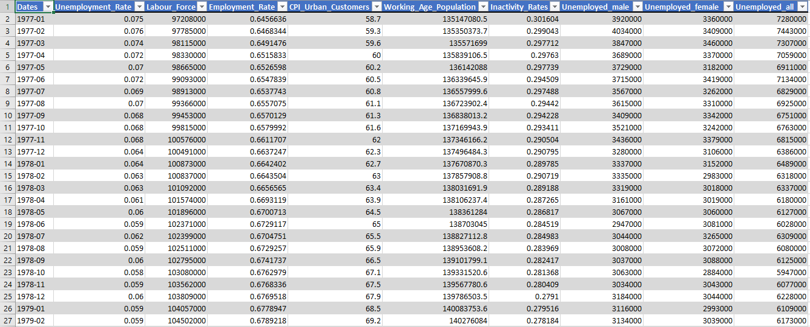
One example of the type of datasets used

Slide 6




Methodologies & Workflow
Importing & preparing the datasets
Historical data at monthly level for all the factors have been imported into the Analytical tool, R Studio from the reliable websites.
Data preparation includes adding new derived variable from the existing factors & deciding upon the final sets of external variables based on Multicollinearity.
Splitting the datasets –Train & Test parts
The latest 6 months data has been taken into “Test” data and the rest has been taken into “Train” data which is used to build and finalize the model.
The “Test” data has been used for validating the final model by comparing the actual values with the predicted ones.
Deciding upon the model parameters and finalizing it using the “Train” set
Here the parameters p, d and q has been finalized where p, d, q are the orders of Auto-Regressive, differencing and Moving Average processes respectively.
Only the significant coefficients are kept in the final model which are decided from the table of test of significance with the corresponding p-values.
Obtaining modelled values & future forecasts
The model, trained on the Train set has been validated on the “Test” set and wherever external regressors are present in final model, the values of those are forecasted for the future months and then used as input. Future forecasts are then obtained as required.
The upper & lower limits are the 95% Confidence intervals.

Slide 7
Final models used for prediction
Canada
Time Frame –> 1976 Jan – 2023 Mar
Final model –> Regression with ARIMA(1,1,2) or ARIMAX(1,1,2)
France
Time Frame –> 1989 Jan – 2023 Feb
Final model –> ARIMA(1,1,1)
Germany
Time Frame –> 1991 Jan – 2023 Mar
Final model –> ARIMA(1,2,2)
Italy
Time Frame –> 2004 Jan – 2023 Mar
Final model –> Regression with ARIMA(0,2,1) or ARIMAX(0,2,1)
Japan
Time Frame –> 1976 Jan – 2023 Mar
Final model –> ARIMA(2,1,1)
UK
Time Frame –> 1997 Jan – 2023 Feb
Final model –> Regression with ARIMA(1,1,1) or ARIMAX(1,1,1)
USA
Time Frame –> 1977 Jan – 2023 Mar
Final model –> Regression with ARIMA(1,1,2) or ARIMAX(1,1,2)

Slide 8

Results from the fitted models

Slide 9
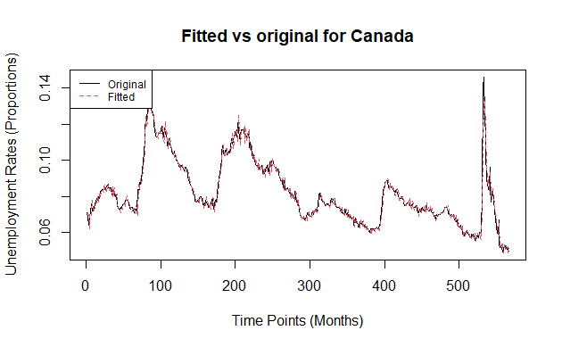
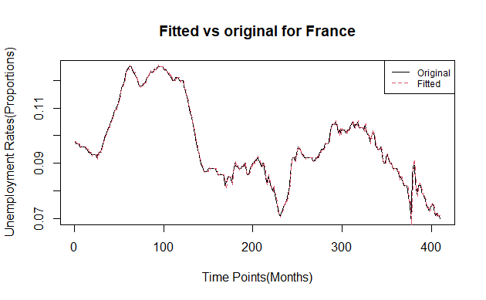
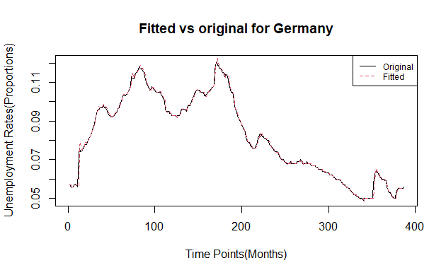
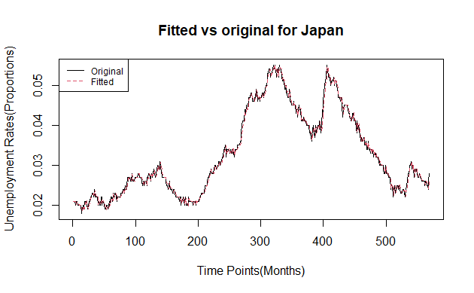
Examples of Actual vs Fitted plots for some of the countries over the years

Slide 10
Comparison b/w Actual & Forecasts of the months that were asked for
Countries | Months | Actuals | Forecasts | Upper Bound | Lower Bound
Canada | May 2023 | 5.20% | 5.01% | 5.62% | 4.41%
France | April 2023 | 7.00% | 6.86% | 7.09% | 6.64%
Germany | May 2023 | 5.60% | 5.63% | 5.90% | 5.36%
Italy | April 2023 | 7.80% | 7.72% | 8.12% | 7.31%
Japan | April 2023 | 2.60% | 2.74% | 2.94% | 2.54%
UK | March 2023 | 3.90% | 3.82% | 3.99% | 3.64%
USA | May 2023 | 3.70% | 3.52% | 3.62% | 3.42%
Root Mean Square Error (RMSE) – 0.00131
Mean Absolute Percentage Error (MAPE) – 2.775%

Slide 11
Some key findings
Inactivity Rates or in other words Labour Force participation rate plays significant role in prediction of unemployment rates in countries like Canada, Italy, USA. As participation of Labour Force decrease, unemployment increases.
For instance, on an average, decrease in participation rate of 100 people leads to unemployment of 65 people in Canada.
CPI plays significant role in unemployment prediction in Italy.
Ratio of male to female unemployment plays more or less significant role in unemployment in UK & USA where we say that the increase in female unemployment may be a cause of concern towards total unemployment.
Average actual weekly hours of work plays moderately significant role towards unemployment in UK.

Slide 12

Things that were beyond the scope like incorporating more factors which can play a vital role in prediction of unemployment, that couldn’t be added here because of limitations, may be due to unavailability of proper reliable data
What’s next?

Slide 13


Hack-HPT - Bibliography
Name – Tathagata Bardhan
Emp id - 165123
Team – NRG
1
THANK
YOU
Name – Priyanka Sarkar
Emp id - 164423
Team – NRG
2
3
Name – Harshit Gola
Emp id - 175058
Team – NRG
Notes:
https://unsplash.com/photos/PhYq704ffdA

